Slide 1
Data Warehousing, Data Mining, and Big Data,Indexing,B+Tree
Presented by: Subhasish Mohapatra

Slide 2
Introduction
Data is the new oil!
Understanding data processes helps businesses make better decisions.
Focus: Data Warehousing, Data Mining, and Big Data.

Slide 3
What is Data Warehousing?
Centralized repository for data.
Stores integrated data from multiple sources.
Supports query and analysis, not transaction processing.

Slide 4
Characteristics of Data Warehouse Architecture:
Subject-oriented: This is designed around subjects (customers, products) or themes rather than the application or transaction. Assembling data around subject areas this is capable of answering business-oriented queries.
Integrated: In Data Warehouse Architecture data from different sources are integrated or brought together into a standardized manner.
Non-volatile: Data is not altered or removed once it is placed into the data warehouse. The non-volatile property of Data Warehouse Architecture provides the data consistency or stability for accurate analysis.
Time variant: The warehouse's data is kept or retained periodically.

Slide 5
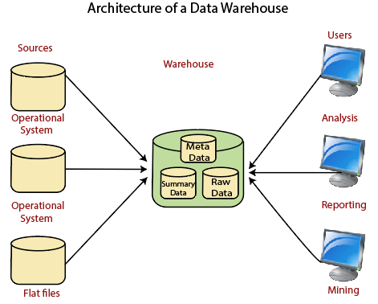

Slide 6
Operational System
An operational system is a method used in data warehousing to refer to a system that is used to process the day-to-day transactions of an organization.
Flat Files
A Flat file system is a system of files in which transactional data is stored, and every file in the system must have a different name.
Meta Data
A set of data that defines and gives information about other data.
Meta Data used in Data Warehouse for a variety of purpose, including:
Meta Data summarizes necessary information about data, which can make finding and work with particular instances of data more accessible. For example, author, data build, and data changed, and file size are examples of very basic document metadata.
Metadata is used to direct a query to the most appropriate data source.
Lightly and highly summarized data
The area of the data warehouse saves all the predefined lightly and highly summarized (aggregated) data generated by the warehouse manager.
The goals of the summarized information are to speed up query performance. The summarized record is updated continuously as new information is loaded into the warehouse.
End-User access Tools
The principal purpose of a data warehouse is to provide information to the business managers for strategic decision-making. These customers interact with the warehouse using end-client access tools.
The examples of some of the end-user access tools can be:
Reporting and Query Tools
Application Development Tools
Executive Information Systems Tools
Online Analytical Processing Tools
Data Mining Tools

Slide 7
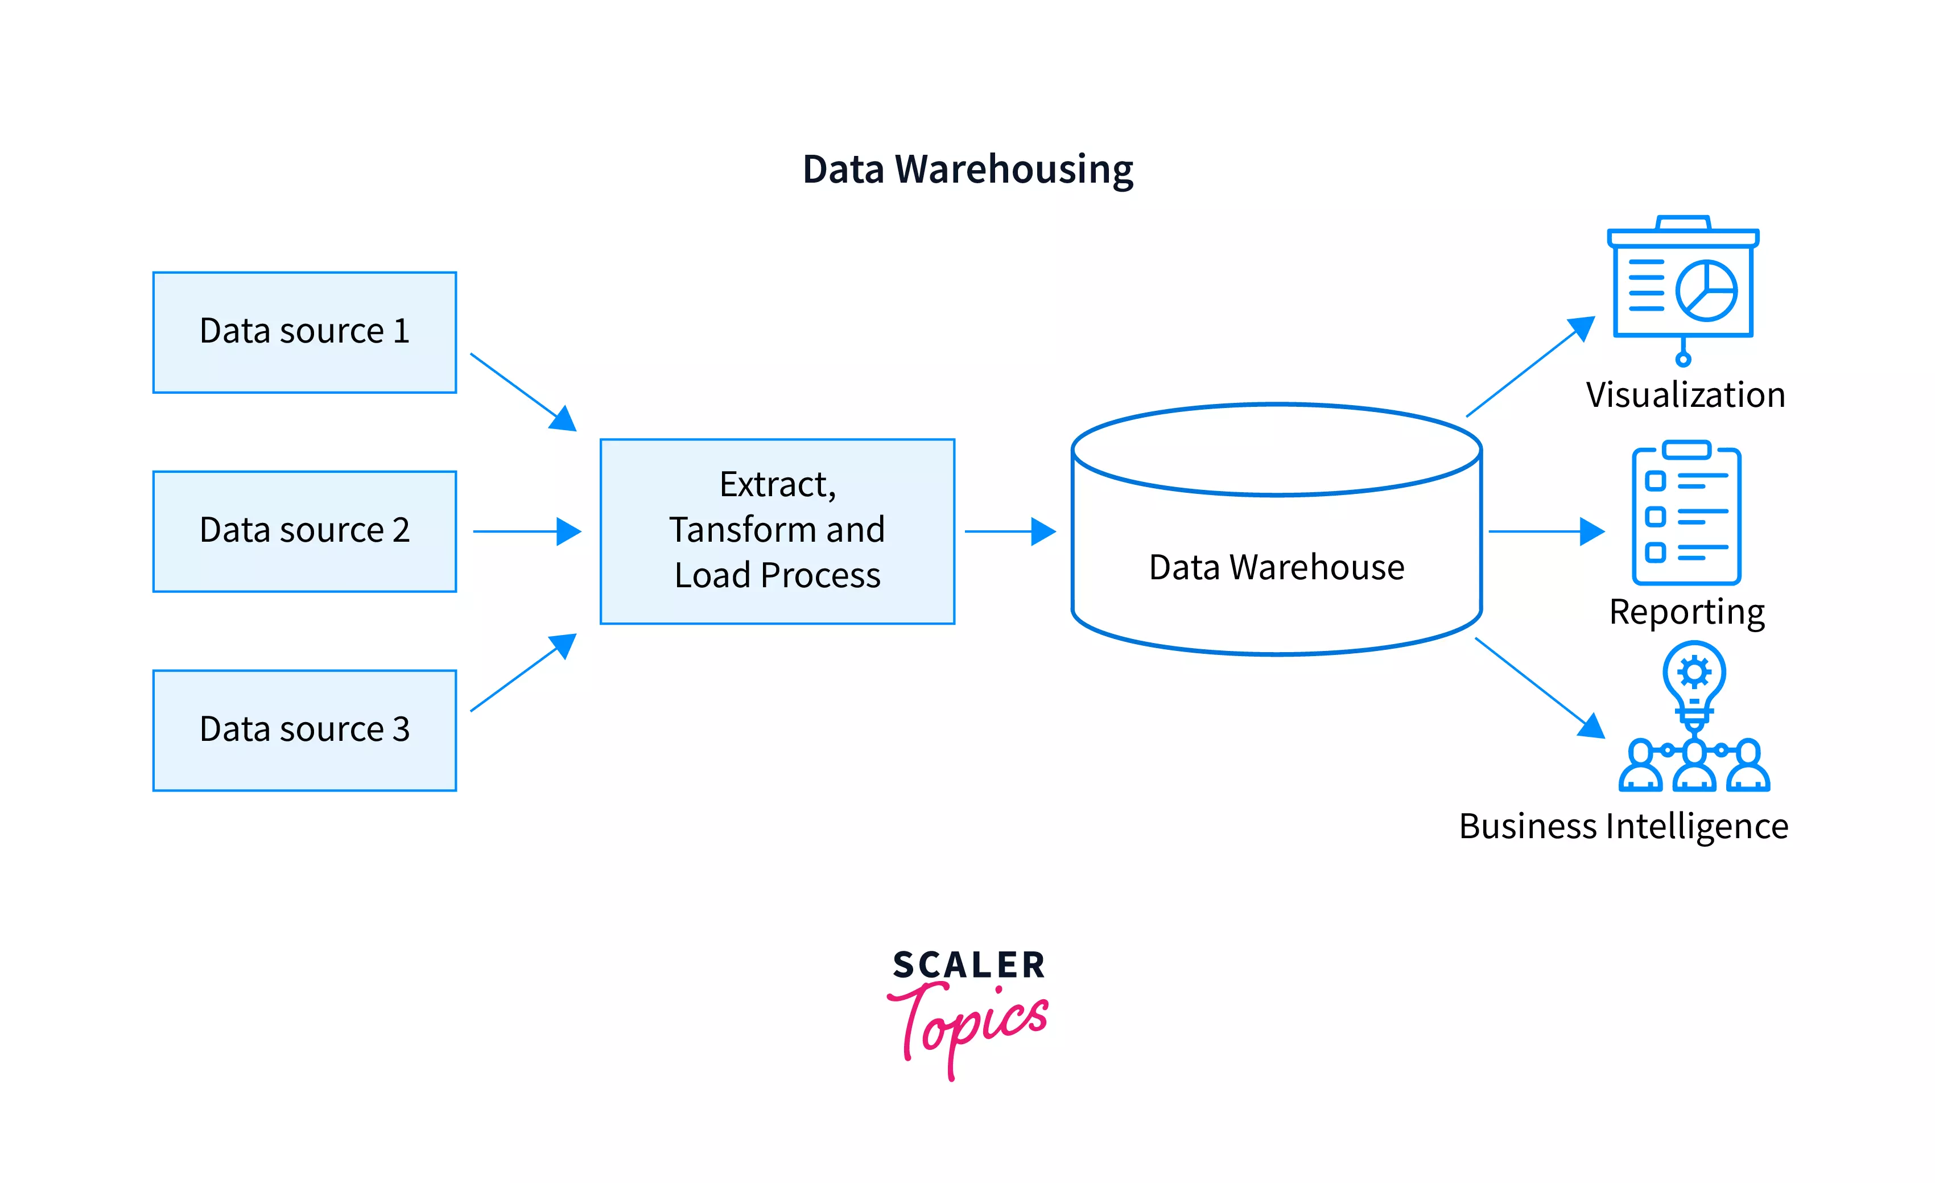

Slide 8
Types of Data Warehouse Architectures
The Single-tier Data Warehouse architecture
• The Two-tier Data Warehouse architecture
• The Three-Tier Data Warehouse Architecture
The Architecture of a Data Warehouse can be quite intriguing at first as it can be considered an information system that has historical commutative data from multiple sources, and to layer down, we have different approaches for constructing the data warehouse layers and the three different types of architecture of Data Warehouse as can be explained from below:

Slide 9
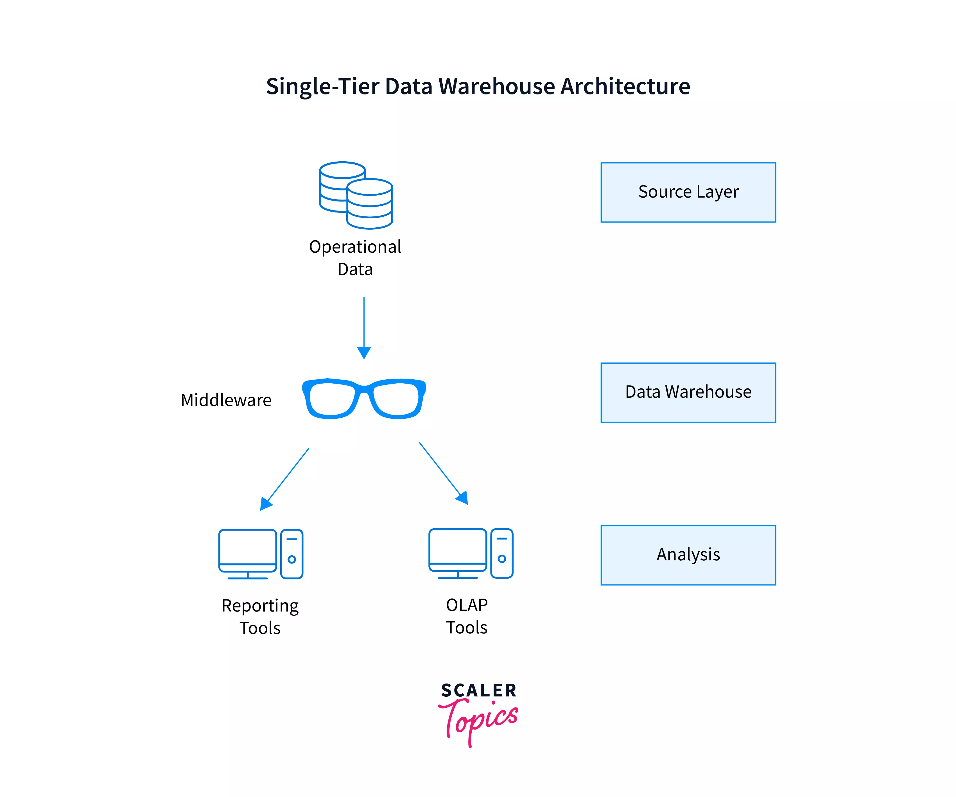

Slide 10
The Two-Tier Data Warehouse Architecture
With the major drawback of single-tier architecture not having a separation of layers for analytical and transactional processing, The two-tier architecture of data warehouse came into the picture. This two-tier architecture vanishes the drawback of the single-tier as it has a separation between the layers which plays an essential role in maintaining the two-tier architecture.
The two-tier architecture of the data warehouse comprises the following two tiers:
1. The Data Tier 2. The Client Tier

Slide 11
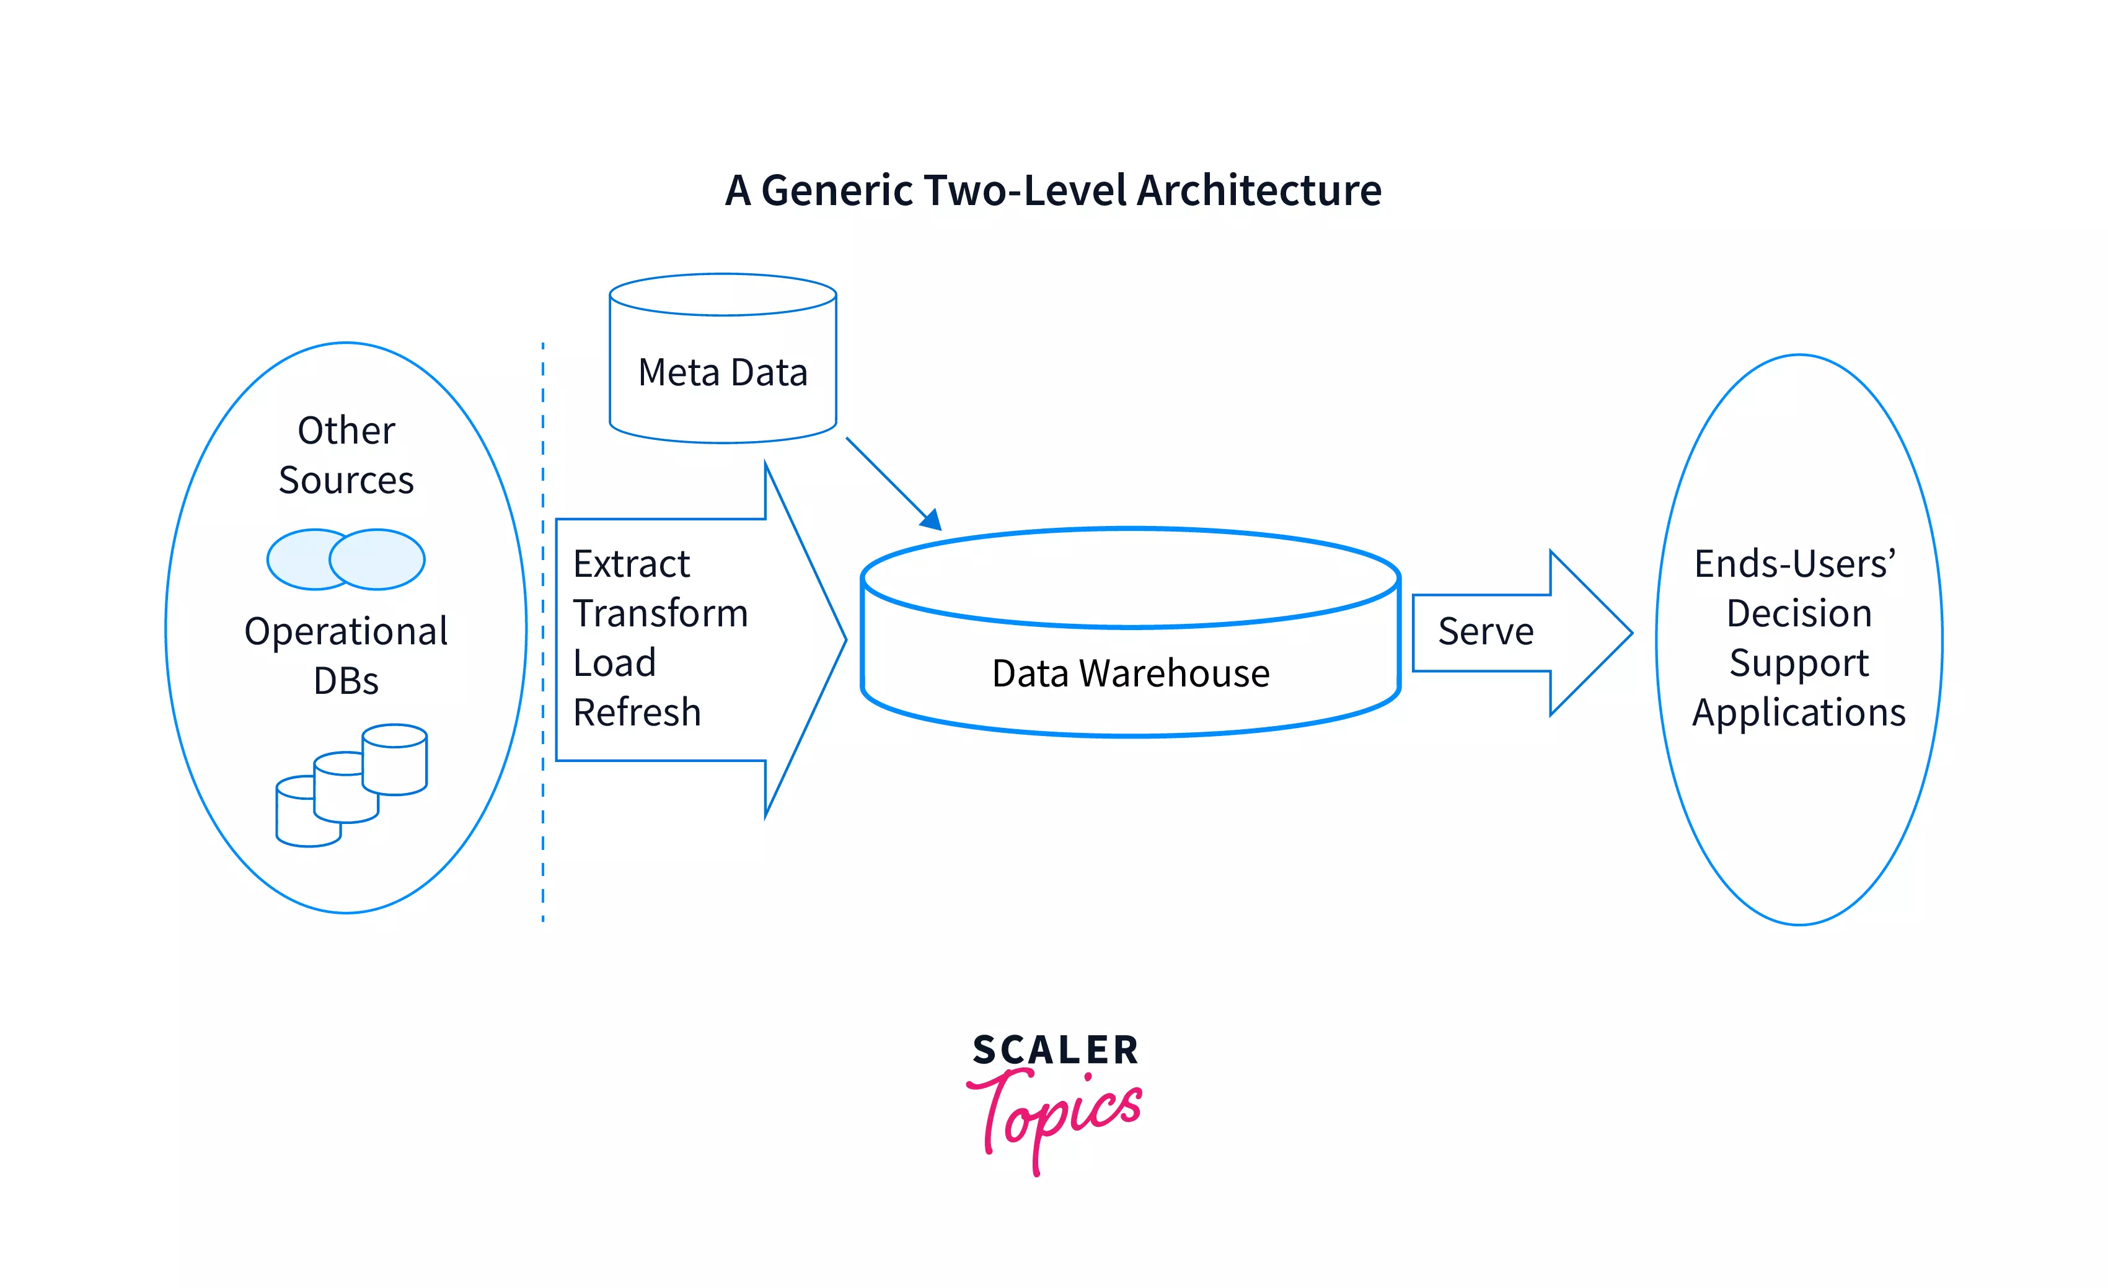

Slide 12
1. The Data Tier
The Data Tier in the two-tier architecture of the data warehouse can be defined as the layer where actual data is stored after various ETL processes are used to load data into the database or the data warehouse.
The staging area where the ETL processes are used in the Data tier helps you ensure that all data loaded into the warehouse is cleansed and in the appropriate format.
This staging area in the two-tier architecture of the data warehouse ensures that data from all sources are collected before the data warehouse layer. With the addition of the staging area between the sources and the storage repository, i.e., the data warehouse, we make sure that all data loaded into the warehouse is in a defined format.
Though it is analyzed as a Data Tier of the Two-Tier architecture, it consists of three subsequent data flow stages to process the data, which can be understood as below:
The Data Tier consists of the following Three layers:
The Source Layer
The Data Staging Layer
The Data Warehouse Layer
A. The Source Layer
This layer is the first layer of the two-tier architecture of the data warehouse. As the data warehouse system uses a heterogeneous source of data, this source layer acts as a repository to store the data from multiple sources that can be stored initially in corporate relational databases. This data can also be stored on legacy databases, or sometimes it comes from sources that are outside the enterprise walls.
B. The Data Staging Layer
This layer is the second layer of the two-tier architecture of the data warehouse. This layer obtains the data stored in the source layer, which is then extracted, cleansed, and integrated to club heterogeneous sources into one standard schema.
The cleansing of the raw data is done to remove inconsistencies and fill gaps in the raw data. We have widely heard of the process called ETL, expanded Extraction, Transformation, and Loading, which plays an important part in this layer of the two-tier architecture of the data warehouse.
The ETL tools then combine multiple schemas into a standard schema, extract, transform, cleanse, validate, filter, and finally load source data into a data warehouse.
C. The Data Warehouse Layer
This layer is the third layer of the two-tier architecture of the data warehouse. The information received from the data staging layer is then saved to one logically centralized individual repository, which is termed as the data warehouse.
Many times the data warehouses can be directly accessed, but it has been observed that sometimes it can also be integrated as a source for creating data marts, which replicate data warehouse contents partially. These are mostly designed for specific enterprise departments.
The Meta-data repositories, which are also an important part of the architecture of the data warehouse, store information about the sources, data staging, access procedures, data mart schema, users, and so on.
As discussed above, once the data coming from multiple external sources is cleansed and transformed, it gets stored in the data warehouse.
Now to actually understand what the data wants to tell us, we introduce the Second tier of the Two-tier Architecture of the data warehouse, That is, The Client Tier.
2. The Client Tier
The Client Tier in the two-tier architecture of the data warehouse can be defined as the layer where data is stored in the data warehouse and can be used by the client to generate insights that can help the organization invent or transform the existing solution/products based on the trends that can be analyzed by the reports generated.
This Client Tier is the front-end application where the clean data is reflected so that the users/client can start their analysis. Many times, the data warehouse reports are hidden in the GUI to show the required reports.
The Client Tier consists of a single layer called the Analysis Layer.
The Analysis layer:
This layer is the fourth layer of the two-tier architecture of the data warehouse. The prime focus in this layer is the integration of data that is efficient and flexible enough to accessibly issue reports, simulate hypothetical business scenarios and dynamic analysis of information.
The analysis layer in the architecture of the data warehouse features aggregate information navigators and efficient query optimizers.
The Two-tier architecture has a primary drawback is that it is not expandable, which in turn also resonates with it not supporting a large number of end-users. We also see connectivity problems because of network limitations that are faced with this type of architecture of data warehouse.

Slide 13
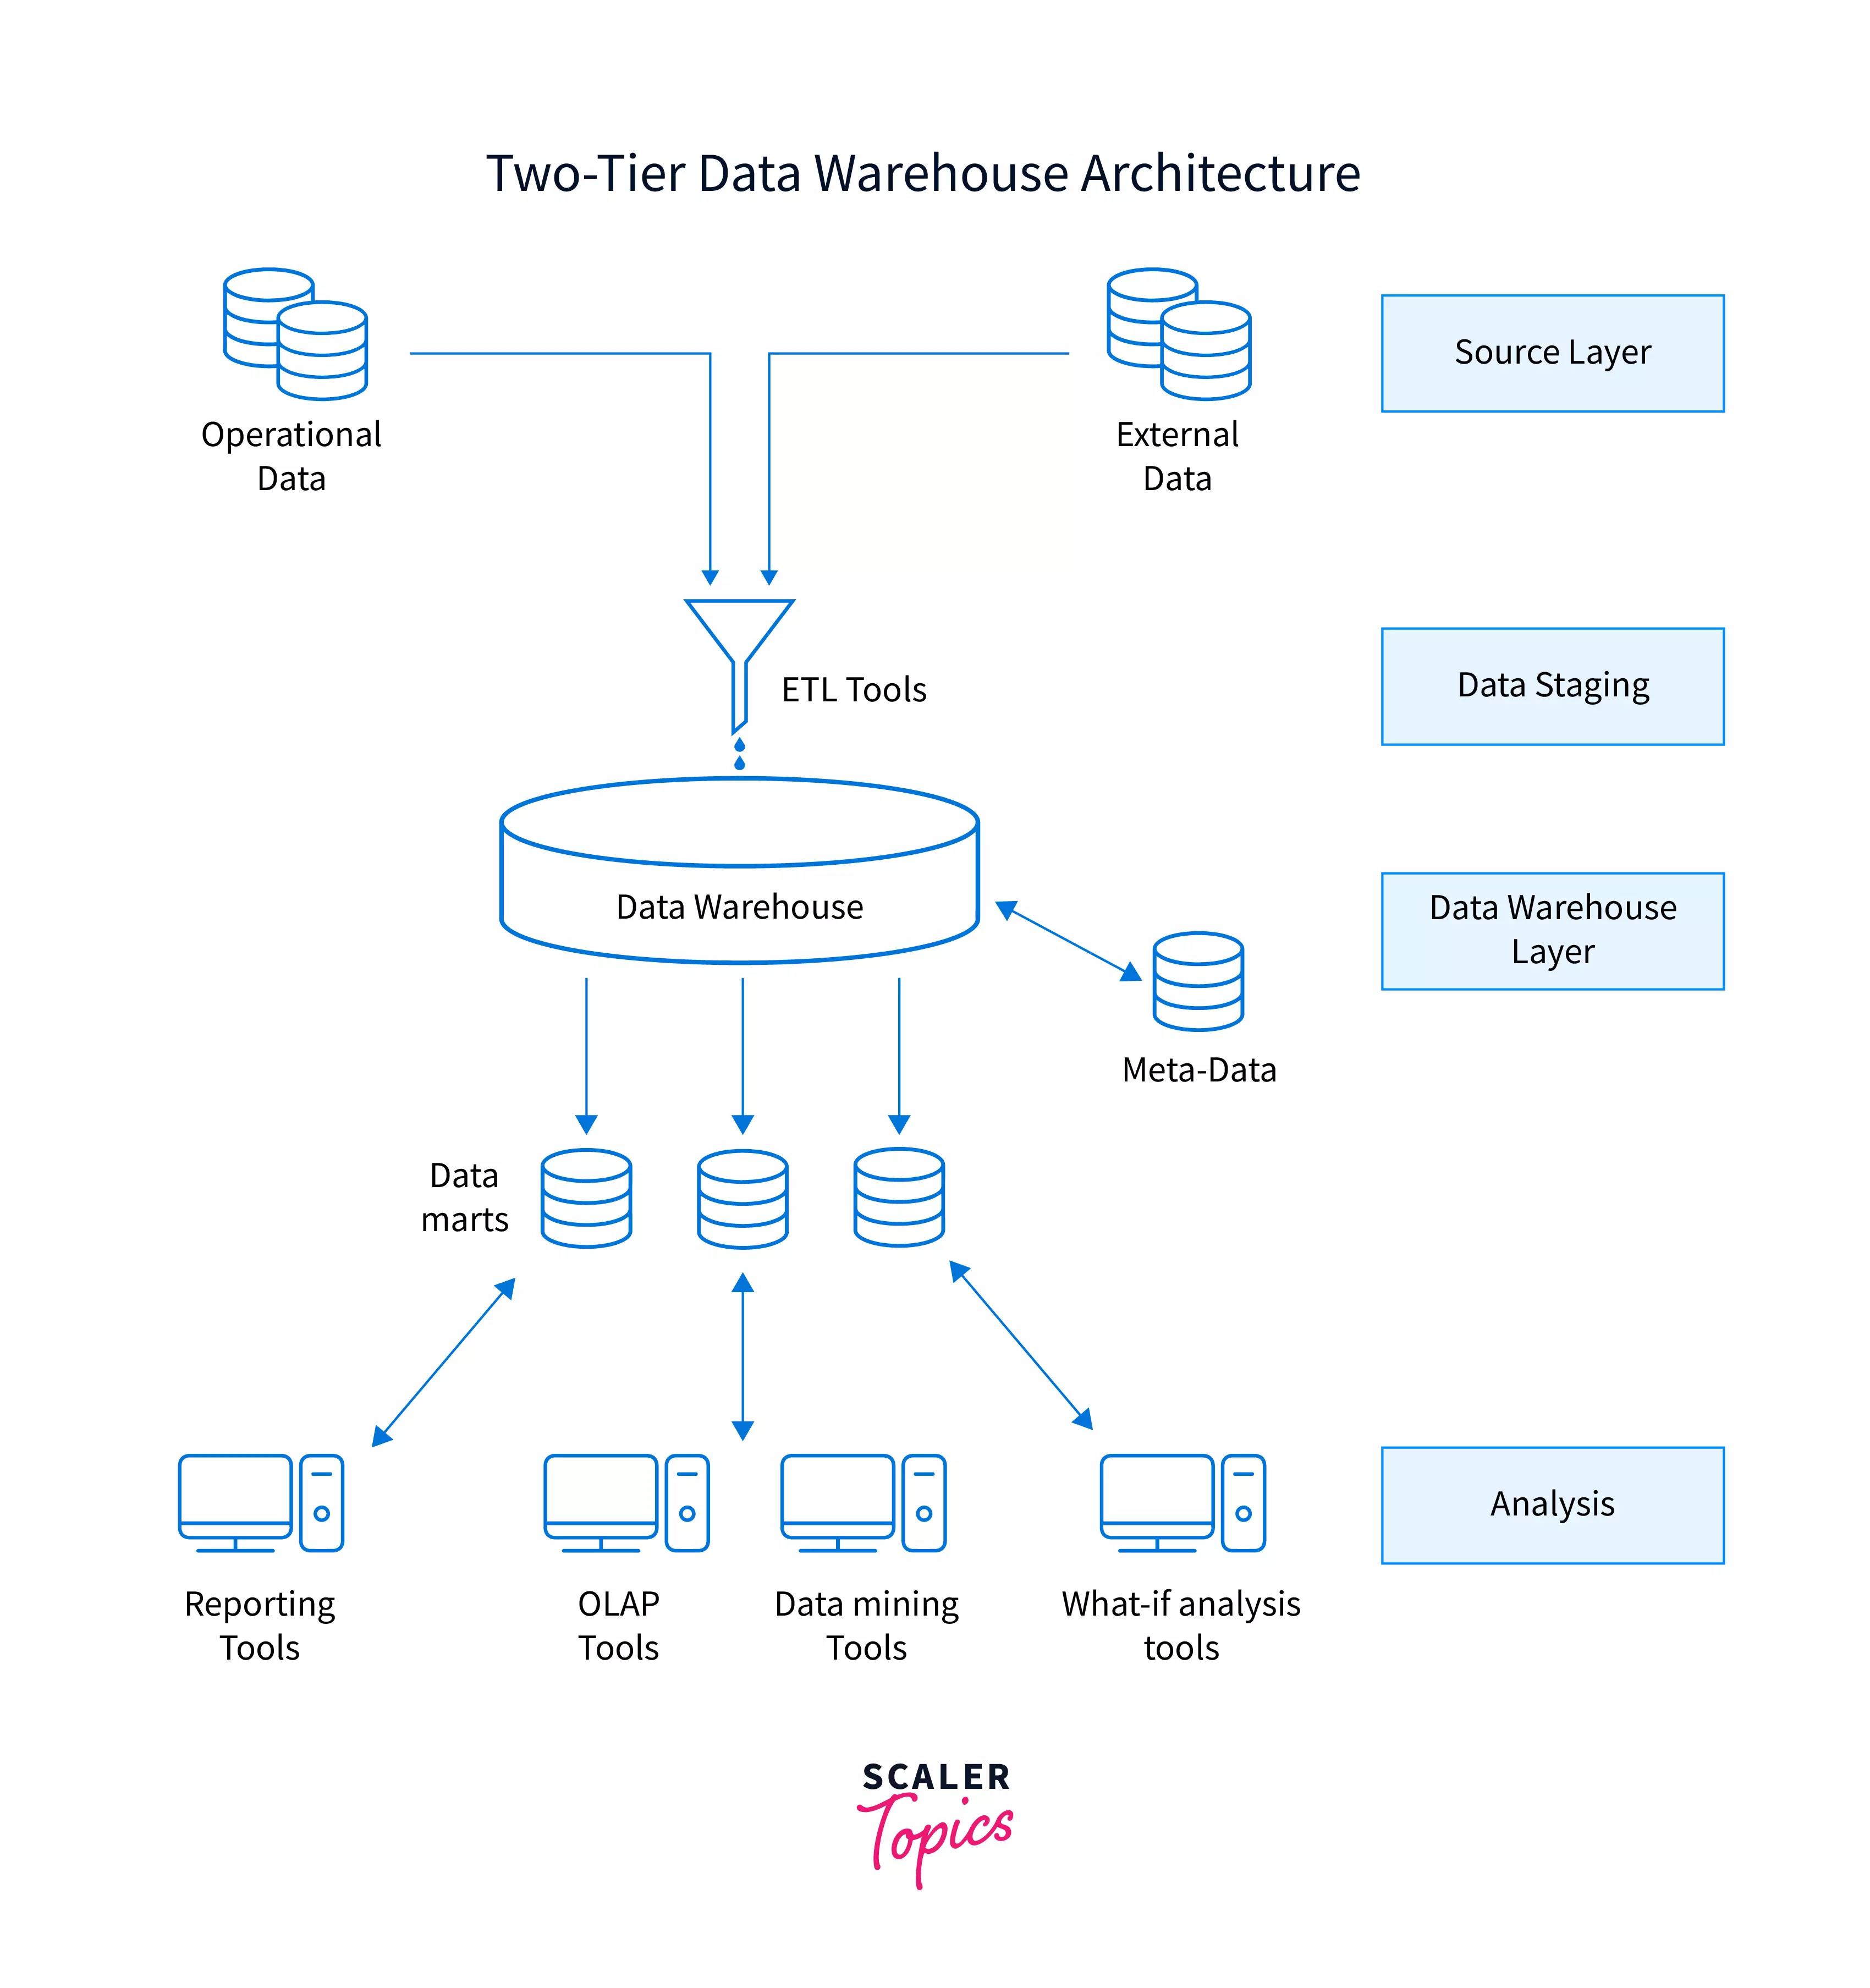

Slide 14
The Three-Tier Data Warehouse Architecture
Solving the limitations of connectivity problems because of network limitations of the two-tier architecture of the data warehouse. We have the most widely used architecture for data warehouse systems.
We have the three-tier architecture of the data warehouse. This three-tier architecture of the data warehouse consists of the source layer (containing heterogeneous source systems), the reconciled layer, and the data warehouse layer (containing both data marts and data warehouses).
Understanding architecture is especially useful for extensive, enterprise-wide systems. A disadvantage of this structure is the extra file storage space used through the redundant reconciled layer. It also makes the analytical tools a little further away from being real-time.
The three tiers of the three-tier architecture of the data warehouse can be classified as below:
1. The Bottom Tier
The bottom tier consists of the database of the Data warehouse servers as the bottom tier for the architecture. We can define this database as a relational database system.
This layer is responsible for cleaning, transforming, and loading the data present in the database from the bottom tier using back-end tools. This layer can also be termed the data warehouse layer (containing both data marts and data warehouses)
2. The Middle Tier
The middle tier consists of the OLAP server. This is widely implemented by using either the ROLAP or the MOLAP model. As this is the middle tier of the architecture of the data warehouse, this acts as a mediator between the end-user and the database.
This tier is presented as an application layer that has an abstract view of the database when a user visits this tier. The middle layer of this three-tier architecture is the reconciled layer which resides between the source data and the data warehouse. As it can create a standard reference data model for a whole organization, this can be considered as its major advantage.
The reconciled layer also helps in separating the problems of data extraction at the source end and integrating that data into the data warehouse population. Be it Producing daily analysis sheets or reports (which cannot be satisfactorily prepared using the enterprise applications) or Periodically generating data flows to feed external processes which can benefit from cleaning and integration of the data in many cases like the reconciled layer (the middle tier of the architecture of data warehouse) is majorly used to directly accomplish better operational tasks.
3. The Top-Tier
The top tier consists of the front-end client layer as the top tier for the architecture. This is widely classified as the tier consisting of the API and tools that we use for connecting and gathering data out from the data warehouse. This is also used as Query tools, reporting tools, managed query tools, Analysis tools, and Data mining tools. This layer can be considered as the source layer (containing heterogeneous source systems.

Slide 15
The Properties of Data Warehouse Architecture
While designing the architecture of the data warehouse, we need to keep in mind the various properties it holds so that we are making the best choices for defining the architecture of the data warehouse.
The five main properties that the Architecture of a data warehouse must hold are as below:
1) Security
It is very important to have a secure architecture of the data warehouse as the data which is processed and stored in the data warehouse should not be accessible by any unlicensed third-party users.
It's highly recommended to monitor accesses that are necessary as the strategic data stored in the data warehouses can range from personal data of the customers or any such data which, when intervened by anyone, can lead to privacy issues.
Therefore, Security is one of the important properties while designing the architecture of the Data Warehouse
2) Administerability
The next property that needs to be kept in mind while designing the Architecture of the Data Warehouse is Administerability. For maintaining Administerability, it is always recommended to have a simple version of the Data Warehouse management; that is it should not be complicated.
3) Scalability
With digitalization ruling the industry, the scalability of architecture plays an important role in designing the architecture of a data warehouse.
This property of scalability must be accommodated when designing as with the rapid growth of digital transformation, it is obvious to make sure that the hardware and software architectures should be kept simple to upgrade the data volume as quickly as possible, which in turn can be managed and processed on demand and can meet the number of user's requirements quickly to have a progressive increase.
4) Extensibility
The fourth property that covers the ability to adjust to the different client needs and gives the Architecture of a Data Warehouse the liberty to accommodate the changes is Extensibility.
With the new technologies emerging and the amount of data getting created, it is highly recommended that the Extensibility of the architecture of the data warehouse be spot on.
We should have an architecture that can upgrade with respect to the demand without redesigning the whole system.
5) Separation
The last important property that needs to be kept in mind while designing the Architecture of the Data Warehouse is Separation. When the amount of data in the data warehouse stored starts to increase can be issues that can start to come up concerning the overlapping of the process, such as analytical or transactional.
Therefore it is always a good point to incorporate proper Separation analysis while designing the Architecture of the Data Warehouse to keep both the Analytical and transactional as apart as possible.

Slide 16
A Data Warehouse is a large, centralized repository of data collected from multiple sources. It is designed to support query and analysis rather than transaction processing. Data is extracted from various operational systems, transformed into a consistent format, and loaded into the warehouse (ETL process: Extract, Transform, Load).
Key Characteristics:
Subject-Oriented: Focuses on specific business areas (e.g., sales, finance).
Integrated: Combines data from different sources.
Time-Variant: Keeps historical data for trend analysis.
Non-Volatile: Once stored, data doesn’t change.
Real-Life Example:
Imagine a Retail Chain like Walmart. Data from sales, inventory, suppliers, and customer feedback is collected daily. This data is stored in a data warehouse, allowing managers to analyze sales trends, manage stock levels, and optimize supply chains.
Use Cases:
Sales performance analysis.
Customer segmentation.
Inventory management.

Slide 17
Data Mining is the process of discovering patterns, correlations, and insights from large datasets. It involves techniques like clustering, classification, and association rules.
Key Techniques:
Classification: Categorizing data (e.g., spam detection).
Clustering: Grouping similar data points (e.g., customer segmentation).
Association Rules: Finding relationships between variables (e.g., “Customers who buy bread also buy butter”).
Real-Life Example:
A Bank might use data mining to detect fraudulent transactions. By analyzing transaction patterns, the system can identify unusual activity, like multiple withdrawals in a short time from different locations, triggering a fraud alert.
Use Cases:
Fraud detection.
Market basket analysis.
Predictive maintenance.

Slide 18
Data mining is the process of sorting through large data sets to identify patterns and relationships that can help solve business problems through data analysis. Data mining techniques and tools help enterprises to predict future trends and make more informed business decisions.
Data mining is a key part of data analytics and one of the core disciplines in data science, which uses advanced analytics techniques to find useful information in data sets. At a more granular level, data mining is a step in the knowledge discovery in databases (KDD) process, a data science methodology for gathering, processing and analyzing data. Data mining and KDD are sometimes referred to interchangeably, but they're more commonly seen as distinct things.
The process of data mining relies on the effective implementation of data collection, warehousing and processing. Data mining can be used to describe a target data set, predict outcomes, detect fraud or security issues, learn more about a user base, or detect bottlenecks and dependencies. It can also be performed automatically or semiautomatically.
Data mining is more useful today due to the growth of big data and data warehousing. Data specialists who use data mining must have coding and programming language experience, as well as statistical knowledge to clean, process and interpret data.

Slide 19
The core elements of data mining include machine learning and statistical analysis, along with data management tasks done to prepare data for analysis. The use of machine learning algorithms and artificial intelligence (AI) tools has automated more of the process. These tools have also made it easier to mine massive data sets, such as customer databases, transaction records and log files from web servers, mobile apps and sensors.
Although the number of stages can differ depending on how granular an organization wants each step to be, the data mining process can generally be broken down into the following four primary stages:
Data gathering. Identify and assemble relevant data for an analytics application. The data might be located in different source systems, a data warehouse or a data lake, an increasingly common repository in big data environments that contain a mix of structured and unstructured data. External data sources can also be used. Wherever the data comes from, a data scientist often moves it to a data lake for the remaining steps in the process.
Data preparation. This stage includes a set of steps to get the data ready to be mined. Data preparation starts with data exploration, profiling and pre-processing, followed by data cleansing work to fix errors and other data quality issues, such as duplicate or missing values. Data transformation is also done to make data sets consistent, unless a data scientist wants to analyze unfiltered raw data for a particular application.
Data mining. Once the data is prepared, a data scientist chooses the appropriate data mining technique and then implements one or more algorithms to do the mining. These techniques, for example, could analyze data relationships and detect patterns, associations and correlations. In machine learning applications, the algorithms typically must be trained on sample data sets to look for the information being sought before they're run against the full set of data.
Data analysis and interpretation. The data mining results are used to create analytical models that can help drive decision-making and other business actions. The data scientist or another member of a data science team must also communicate the findings to business executives and users, often through data visualization and the use of data storytelling techniques.

Slide 20
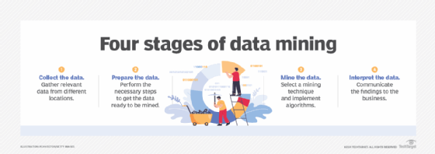

Slide 21
Types of data mining techniques
Various techniques can be used to mine data for different data science applications. Pattern recognition is a common data mining use case, as is anomaly detection, which helps identify outlier values in data sets. Popular data mining techniques include the following types:
Association rule mining. In data mining, association rules are if-then statements that identify relationships between data elements. Support and confidence criteria are used to assess the relationships. Support measures how frequently the related elements appear in a data set, while confidence reflects the number of times an if-then statement is accurate.
Classification. This approach assigns the elements in data sets to different categories defined as part of the data mining process. Decision trees, Naive Bayes classifiers, k-nearest neighbors (KNN) and logistic regression are examples of classification methods.
Clustering. In this case, data elements that share particular characteristics are grouped together into clusters as part of data mining applications. Examples include k-means clustering, hierarchical clustering and Gaussian mixture models.
Regression. This method finds relationships in data sets by calculating predicted data values based on a set of variables. Linear regression and multivariate regression are examples. Decision trees and other classification methods can also be used to do regressions.
Sequence and path analysis. Data can also be mined to look for patterns in which a particular set of events or values leads to later ones.
Neural networks. A neural network is a set of algorithms that simulates the activity of the human brain, where data is processed using nodes. Neural networks are particularly useful in complex pattern recognition applications involving deep learning, a more advanced offshoot of machine learning.
Decision trees. This process classifies or predicts potential results using either classification or regression methods. Treelike structures are used to represent the potential decision outcomes.
KNN. This data mining method classifies data based on its proximity to other data points. Assuming nearby data points are more similar to each other than other data points, KNN is used to predict group features.
Data mining software and tools
Numerous vendors offer data mining tools, typically as part of software platforms that also include other types of data science and advanced analytics tools. Data mining software provides key features, including data preparation capabilities, built-in algorithms, predictive modeling support, a graphical user interface-based development environment, and tools for deploying models and scoring how they perform.
A sampling of vendors that offer tools for data mining is Alteryx, Dataiku, H2O.ai, IBM, Knime, Microsoft, Oracle, RapidMiner, SAP, SAS Institute and Tibco Software.
A variety of free open source technologies can also be used to mine data, including DataMelt, Elki, Orange, Rattle, scikit-learn and Weka. Some software vendors also provide open source options. For example, Knime combines an open source analytics platform with commercial software for managing data science applications, while companies such as Dataiku and H2O.ai offer free versions of their tools.

Slide 22
Benefits of data mining
In general, the business benefits of data mining come from the increased ability of an organization to uncover hidden patterns, trends, correlations and anomalies in data sets. They can use that information to improve business decision-making and strategic planning through a combination of conventional data analysis and predictive analytics.
Specific data mining benefits include the following:
More effective marketing and sales. Data mining helps marketers better understand customer behavior and preferences, which helps them create targeted marketing and advertising campaigns. Similarly, sales teams can use data mining results to improve lead conversion rates and sell additional products and services to existing customers.
Better customer service. Data mining helps companies identify potential customer service issues more promptly and give contact center agents up-to-date information to use in calls and online chats with customers.
Improved SCM. Organizations can spot market trends and forecast product demand more accurately, enabling them to better manage inventories of goods and supplies. Supply chain managers can also use information from data mining to optimize warehousing, distribution and other logistics operations.
Increased production uptime. Mining operational data from sensors on manufacturing machines and other industrial equipment supports predictive maintenance applications to identify potential problems before they occur, helping to avoid unscheduled downtime.
Stronger risk management. Risk managers and business executives can better assess financial, legal, cybersecurity and other risks to a company and develop plans for managing them.
Lower costs. Data mining helps improve cost savings through operational efficiencies in business processes and reduces redundancy and waste in corporate spending.
Ultimately, data mining initiatives can lead to higher revenue and profits, as well as competitive advantages that set companies apart from their business rivals.
Industry examples of data mining
Organizations in the following industries use data mining as part of their analytics applications:
Retail. Online retailers mine customer data and internet clickstream records to help them target marketing campaigns, ads and promotional offers to individual shoppers. Data mining and predictive modeling also power the recommendation engines that suggest possible purchases to website visitors, as well as inventory and SCM activities.
Financial services. Banks and credit card companies use data mining tools to build financial risk models, detect fraudulent transactions, and vet loan and credit applications. Data mining also plays a key role in marketing and identifying potential upselling opportunities with existing customers.
Insurance. Insurers rely on data mining to aid in pricing insurance policies and deciding whether to approve policy applications, as well as for risk modeling and managing prospective customers.
Manufacturing. Data mining applications for manufacturers include efforts to improve uptime and operational efficiency in production plants, supply chain performance and product safety.
Entertainment. Streaming services analyze what users are watching or listening to and make personalized recommendations based on their viewing and listening habits. Likewise, individuals might data mine software to learn more about it.
Healthcare. Data mining helps doctors diagnose medical conditions, treat patients, and analyze X-rays and other medical imaging results. Medical research also depends heavily on data mining, machine learning and other forms of analytics.

Slide 23
3. Big Data
Big Data refers to extremely large datasets that cannot be processed using traditional data management tools. It’s defined by the 3 V’s:
Volume: Massive amounts of data.
Velocity: High speed of data generation.
Variety: Different data types (structured, unstructured, semi-structured).
Real-Life Example:
In Healthcare, wearable devices like smartwatches generate vast amounts of health data (heart rate, steps, sleep patterns) every second. Analyzing this data in real-time can help doctors monitor patients remotely and detect abnormalities early.
Technologies Used:
Hadoop, Spark for processing.
NoSQL databases like MongoDB.
Cloud platforms like AWS, Azure.
Use Cases:
Real-time traffic monitoring (Google Maps).
Personalized recommendations (Netflix, Amazon).
Social media sentiment analysis.

Slide 24
What Is Big Data? Big Data Defined
Big data refers to extremely large and complex data sets that cannot be easily managed or analyzed with traditional data processing tools, particularly spreadsheets. Big data includes structured data, like an inventory database or list of financial transactions; unstructured data, such as social posts or videos; and mixed data sets, like those used to train large language models for AI. These data sets might include anything from the works of Shakespeare to a company’s budget spreadsheets for the last 10 years.
Big data has only gotten bigger as recent technological breakthroughs have significantly reduced the cost of storage and compute, making it easier and less expensive to store more data than ever before. With that increased volume, companies can make more accurate and precise business decisions with their data. But achieving full value from big data isn’t only about analyzing it—which is a whole other benefit. It’s an entire discovery process that requires insightful analysts, business users, and executives who ask the right questions, recognize patterns, make informed assumptions, and predict behavior.
What are the Five “Vs” of Big Data?
Traditionally, we’ve recognized big data by three characteristics: variety, volume, and velocity, also known as the “three Vs.” However, two additional Vs have emerged over the past few years: value and veracity.
Those additions make sense because today, data has become capital. Think of some of the world’s biggest tech companies. Many of the products they offer are based on their data, which they’re constantly analyzing to produce more efficiency and develop new initiatives. Success depends on all five Vs.
Volume. The amount of data matters. With big data, you’ll have to process high volumes of low-density, unstructured data. This can be data of unknown value, such as X (formerly Twitter) data feeds, clickstreams on a web page or a mobile app, or sensor-enabled equipment. For some organizations, this might be tens of terabytes of data. For others, it may be hundreds of petabytes.
Velocity. Velocity is the fast rate at which data is received and (perhaps) acted on. Normally, the highest velocity of data streams directly into memory versus being written to disk. Some internet-enabled smart products operate in real time or near real time and will require real-time evaluation and action.
Variety. Variety refers to the many types of data that are available. Traditional data types were structured and fit neatly in a relational database. With the rise of big data, data comes in new unstructured data types. Unstructured and semistructured data types, such as text, audio, and video, require additional preprocessing to derive meaning and support metadata.
Veracity. How truthful is your data—and how much can you rely on it? The idea of veracity in data is tied to other functional concepts, such as data quality and data integrity. Ultimately, these all overlap and steward the organization to a data repository that delivers high-quality, accurate, and reliable data to power insights and decisions.
Value. Data has intrinsic value in business. But it’s of no use until that value is discovered. Because big data assembles both breadth and depth of insights, somewhere within all of that information lies insights that can benefit your organization. This value can be internal, such as operational processes that might be optimized, or external, such as customer profile suggestions that can maximize engagement.

Slide 25
Big Data Benefits
Big data services enable a more comprehensive understanding of trends and patterns, by integrating diverse data sets to form a complete picture. This fusion not only facilitates retrospective analysis but also enhances predictive capabilities, allowing for more accurate forecasts and strategic decision-making. Additionally, when combined with AI, big data transcends traditional analytics, empowering organizations to unlock innovative solutions and drive transformational outcomes.
More complete answers mean more confidence in the data—which means a completely different approach to tackling problems.
Better insights. When organizations have more data, they’re able to derive better insights. In some cases, the broader range confirms gut instincts against a more diverse set of circumstances. In other cases, a larger pool of data uncovers previously hidden connections and expands potentially missed perspectives. All of this allows organizations to have a more comprehensive understanding into the how and why of things, particularly when automation allows for faster, easier processing of big data.
Decision-making. With better insights, organizations can make data-driven decisions with more reliable projections and predictions. When big data combines with automation and analytics, that opens an entire range of possibilities, including more up-to-date market trends, social media analysis, and patterns that inform risk management.
Personalized customer experiences. Big data allows organizations to build customer profiles through a combination of customer sales data, industry demographic data, and related data such as social media activity and marketing campaign engagement. Before automation and analytics, this type of personalization was impossible due to its sheer scope; with big data, this level of granularity improves engagement and enhances the customer experience.
Improved operational efficiency. Every department generates data, even when teams don’t really think about it. That means that every department can benefit from data on an operational level for tasks such as detecting process anomalies, identifying patterns for maintenance and resource use, and highlighting hidden drivers of human error. Whether technical problems or staff performance issues, big data produces insights about how an organization operates—and how it can improve.
Big Data Use Cases
Big data can help you optimize a range of business activities, including customer experience and analytics. Here are just a few.
1. Retail and ecommerce. Companies such as Netflix and Procter & Gamble use big data to anticipate customer demand. They build predictive models for new products and services by classifying key attributes of past and current products or services and modeling the relationship between those attributes and the commercial success of the offerings. In addition, P&G uses data and analytics from focus groups, social media, test markets, and early store rollouts to plan, produce, and launch new products.
2. Healthcare. The healthcare industry can combine numerous data sources internally, such as electronic health records, patient wearable devices, and staffing data, and externally, including insurance records and disease studies, to optimize both provider and patient experiences. Internally, staffing schedules, supply chains, and facility management can be optimized with insights provided by operations teams. For patients, their immediate and long-term care can change with data driving everything such as personalized recommendations and predictive scans.
3. Financial services. When it comes to security, it’s not just a few rogue attackers—you’re up against entire expert teams. Security landscapes and compliance requirements are constantly evolving. Big data helps you identify patterns in data that indicate fraud and aggregate large volumes of information to make regulatory reporting much faster.
4. Manufacturing. Factors that can predict mechanical failures may be deeply buried in structured data—think the year, make, and model of equipment—as well as in unstructured data that covers millions of log entries, sensor data, error messages, and engine temperature readings. By analyzing these indications of potential issues before problems happen, organizations can deploy maintenance more cost effectively and maximize parts and equipment uptime.
5. Government and public services. Government offices can potentially collect data from many different sources, such as DMV records, traffic data, police/firefighter data, public school records, and more. This can drive efficiencies in many different ways, such as detecting driver trends for optimized intersection management and better resource allocation in schools. Governments can also post data publicly, allowing for improved transparency to bolster public trust.

Slide 26
How Big Data Works
Big data works by providing insights that shine a light on new opportunities and business models. Once data has been ingested, getting started involves three key actions:
1. Integrate
Big data brings together data from many disparate sources and applications. Traditional data integration mechanisms, such as extract, transform, and load (ETL) generally aren’t up to the task. It requires new strategies and technologies to analyze big data sets at terabyte, or even petabyte, scale.
During integration, you need to bring in the data, process it, and make sure it’s formatted and available in a form that your business analysts can get started with.
2. Manage
Big data requires storage. Your storage solution can be in the cloud, on-premises, or both. You can store your data in any form you want and bring your desired processing requirements and necessary process engines to those data sets on an on-demand basis. Many people choose their storage solution according to where their data is currently residing. Data lakes are gradually gaining popularity because it supports your current compute requirements and enables you to spin up resources as needed.
3. Analyze
Your investment in big data pays off when you analyze and act on your data. A visual analysis of your varied data sets gives you new clarity. Explore the data further to make new discoveries. Share your findings with others. Build data models with machine learning and artificial intelligence. Put your data to work for your organization.
Big Data Best Practices
To help you on your big data journey, we’ve put together some key best practices for you to keep in mind. Here are our guidelines for building a successful big data foundation.
1. Align big data with specific business goals
More extensive data sets enable you to make new discoveries. To that end, it is important to base new investments in skills, organization, or infrastructure with a strong business-driven context to guarantee ongoing project investments and funding. To determine if you are on the right track, ask how big data supports and enables your top business and IT priorities. Examples include understanding how to filter web logs to understand ecommerce behavior, deriving sentiment from social media and customer support interactions, and understanding statistical correlation methods and their relevance for customer, product, manufacturing, and engineering data.
2. Ease skills shortages with standards and governance
One of the biggest obstacles to benefiting from your investment in big data is not having enough staff with the necessary skills to analyze your data. You can mitigate this risk by ensuring that big data technologies, considerations, and decisions are added to your IT governance program. Standardizing your approach will allow you to manage costs and leverage resources. Organizations implementing big data solutions and strategies should assess their skill requirements early and often and should proactively identify any potential skill gaps. These can be addressed by training/cross-training existing resources, hiring new resources, and leveraging consulting firms.

Slide 27
Fundamentals of Object-Oriented Databases (OODB):
An Object-Oriented Database (OODB) integrates object-oriented programming principles with database technology. It allows data to be represented as objects, similar to programming languages like Java, Python, or C++.
Key Concepts:
Objects: Real-world entities represented with attributes and methods.
Classes: Blueprints for objects, defining attributes and behaviors.
Inheritance: Enables new classes to inherit properties from existing ones, reducing redundancy.
Encapsulation: Hides internal object details, exposing only necessary functionalities.
Polymorphism: Allows objects to be treated as instances of their parent class, enhancing flexibility.
Advantages:
Closer integration with object-oriented applications.
Improved data modeling for complex data.
Supports multimedia and complex data types (e.g., images, videos).
Real-Life Example:
In a Healthcare System, a "Patient" class may have attributes like "Name" and "Age" and methods like "ScheduleAppointment()". Specialized classes like "Inpatient" and "Outpatient" can inherit these attributes and methods while adding unique ones.

Slide 28
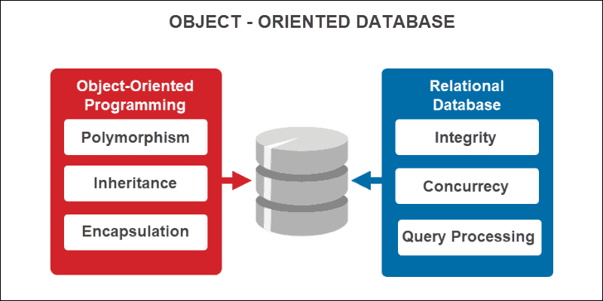

Slide 29
An object-oriented database (OODB) is a database that combines object-oriented programming concepts with relational database principles. It is managed by an object-oriented database management system (OODBMS). OODBs contain the following elements:
Objects. The basic building block and an instance of a class. The type is either built-in or user-defined.
Classes. A schema or blueprint that defines object structure and behavior.
Methods. A blueprint that defines the behavior of a class.
Pointers. An entity that helps access elements of an object database. They also help establish relationships between objects.

Slide 30
Object-Oriented Database (OODB) vs. Other Types of Databases
Object-oriented databases significantly differ from other database types in their design and functionality. Knowing these differences can help determine when using an OODB is the best choice. Below is a brief comparison between OODB and other types of databases.
OODB vs. Relational Databases
The main difference between the two is how the data is structured:
Relational databases. Data resides in structured tables with rows and columns. It is queried using SQL, focusing mainly on data consistency and normalization.
OODB. Data is stored as a complete and complex object. It supports complex data types and inheritance. The main focus is to minimize the difference between a database structure and a programming language.

Slide 31
OODB vs. Document-Oriented Databases (NoSQL)
A notable difference is in their applicability:
Document-oriented databases (NoSQL). Data is unstructured or semi-structured. Caters to various data models, with a focus on scalability and flexibility.
OODB. Manages objects with built-in relationships and behaviors. Ideal for complex data structures or for integration with object-oriented programming.
OODB vs. Key-Value Databases
The two database types differ in complexity:
Key-value databases. A simple structure with key-value pairs. Ideal for lookup tables and data caching, but there is no support for complex relationships.
OODB. Supports complex relationships, inheritance, and encapsulation.
OODB vs. Graph Databases
Relationships are a key difference between these two database types:
Graph databases. Structured for highly connected data. Uses edges and nodes to represent relationships between entities.
OODB. Focuses on objects and their behavior while supporting relationships, though not as interconnected as graph databases.

Slide 32
Object-Oriented Programming Concepts in Database Management
Object-oriented databases closely relate to object-oriented programming (OOP) concepts. The four main features of OOP are:
Polymorphism.
Inheritance.
Encapsulation.
Abstraction.
These four attributes describe the main characteristics of object-oriented management systems in general. The sections below explain each of these concepts in greater depth.
Polymorphism
Polymorphism is the capability of an object to take multiple forms. This ability allows the same program code to work with different data types.
To illustrate, a Vehicle class can be defined to have a method called brake(). A Car and a Bike can both inherit from the class and implement their version of the brake() method. The same method is applied for different behaviors, resulting in polymorphism.
Inheritance
Inheritance creates a hierarchical relationship between related classes while making parts of code reusable. Defining new types inherits all the existing class fields and methods plus further extends them. The existing class is the parent class, while the child class extends the parent.
For example, a parent class called Vehicle can have child classes such as Car and Bike. Both child classes inherit information from the parent class. They also extend the parent class with new information depending on the methods defined for each vehicle type.
Encapsulation
Encapsulation allows grouping variables and methods into a single object to create access protection. This process hides information and details of how an object works from the rest of the code and results in data and function security.
Classes interact with each other through interface methods without the need to know how particular methods work.

Slide 33
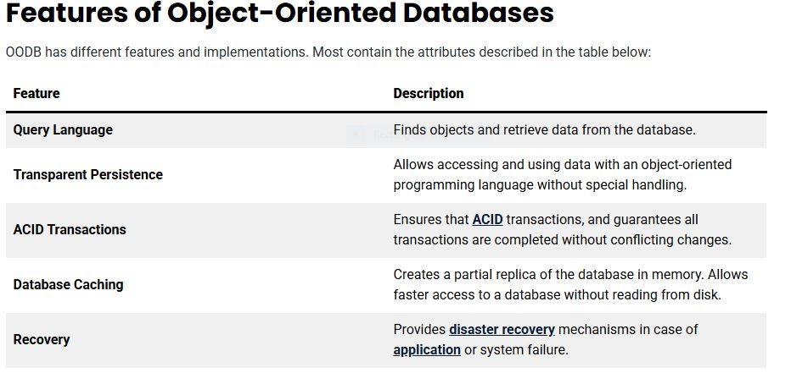

Slide 34
GemStone/S
GemStone/S is an object database system based on Smalltalk, an object-oriented programming language influenced by Java. Developers who write applications in Smalltalk can quickly adapt to this database, although the language is uncommon. GemStone/S integrates seamlessly with existing applications written in this language, improving speed and productivity.
ObjectDB
ObjectDB is a NoSQL object database for the Java programming language. Compared to other NoSQL databases, ObjectDB is ACID compliant. ObjectDB does not provide an API and requires using one of the two built-in Java database APIs:
JPA with JPA Query Language (JPQL) based on Java syntax.
JDO with JDO Query Language (JDQL) based on SQL syntax.

Slide 35
Benefits of Object-Oriented Databases
The main advantages of OODBs are:
Complex data and a wider variety of data types compared to MySQL data types.
Easy to save and retrieve data quickly.
Seamless integration with object-oriented programming languages.
Easier to model advanced real-world problems.
Extensible with custom data types.
Challenges of Object-Oriented Databases
Some disadvantages of OODBs include:
It is not as widely adopted as relational databases.
No universal data model. Lacks theoretical foundations and standards.
Does not support views.
High complexity, which may lead to performance issues.
An adequate security mechanism and access rights to objects do not exist.

Slide 36
What are Parallel Databases?
A Parallel Database is a database that is built up of multiple processors and storage units, located in one physical environment or they belong to a closely coupled system and are involved in performing the database tasks in parallel. Single processor systems can no longer meet-requirements of scalability and performance and also the same throughput can be achieved as single, larger machine by replacing with multiple smaller machines.
Parallel Databases can be broken down into 3 categories
Shared Memory
Shared Disk
Shared Nothing
1. Shared Memory
Multiple processors have direct access to single, shared memory space, this means all processors work with the same memory.

Slide 37
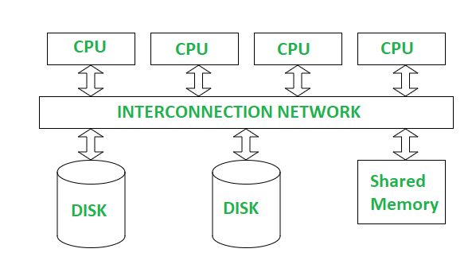

Slide 38
How It Works: Think of it like multiple people working on a single whiteboard. They can all see and change the information on it right away.
2. Shared Disk
In a Shared Disk architecture, each processor has its own memory, but all processors share the same disk (or storage). Processors can read/write to the same disk, but have separate memories. Remember that each node has it’s own Operation System

Slide 39
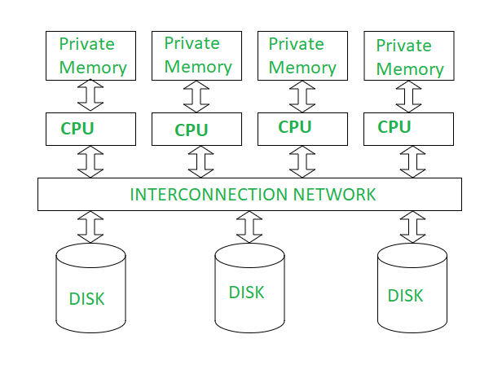

Slide 40
How It Works: Imagine several people with their own notebooks (memory) working together, but they all write to and read from a shared filing cabinet (disk).
3. Shared Nothing
In a Shared Nothing architecture, each processor has its own memory and its own disk. The processors work independently, and they communicate only when needed. There’s no shared memory/disk, so each processor manages its own data.

Slide 41
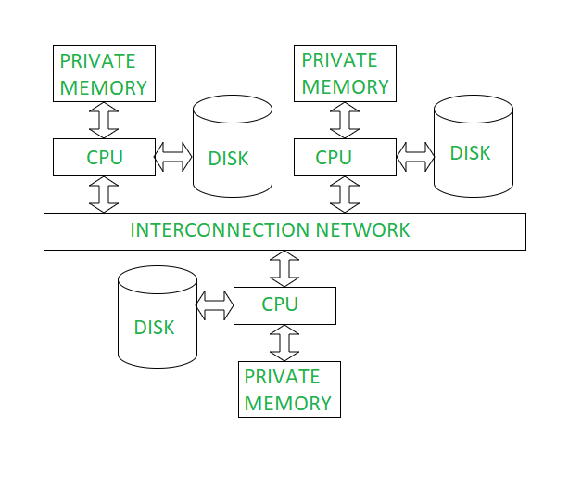

Slide 42
How It Works: Imagine each person has their own notebook and their own filing cabinet, and they work independently. If they need to share information, they communicate over a network.
Advantages
Parallel Query Execution
By splitting a query into multiple smaller tasks and executing them concurrently across different processors or nodes, parallel databases can reduce the time required to execute complex queries.
Faster Data Processing
Query operations can be performed in parallel, resulting in quicker processing compared to traditional single-processor systems.
Horizontal Scalability
Parallel databases can be scaled by adding more nodes or processors, which increases the system’s ability to handle larger datasets and more complex queries. This is particularly useful for big data applications. This also saves the cost and attractive way of dealing with increasing data volumes
Disadvantages
Complex Data Synchronisation
In parallel databases, especially in distributed systems, ensuring data consistency across all nodes can be challenging. Bottlenecks can appear!
High Communication Costs
Since multiple nodes in a parallel database system often need to communicate and exchange data, network bandwidth can become a problem, particularly if the nodes are distributed across different locations (e.g., in a cloud environment).

Slide 43
What are distributed databases?
A logically interrelated collection of data that is distributed physically over a network.

Slide 44
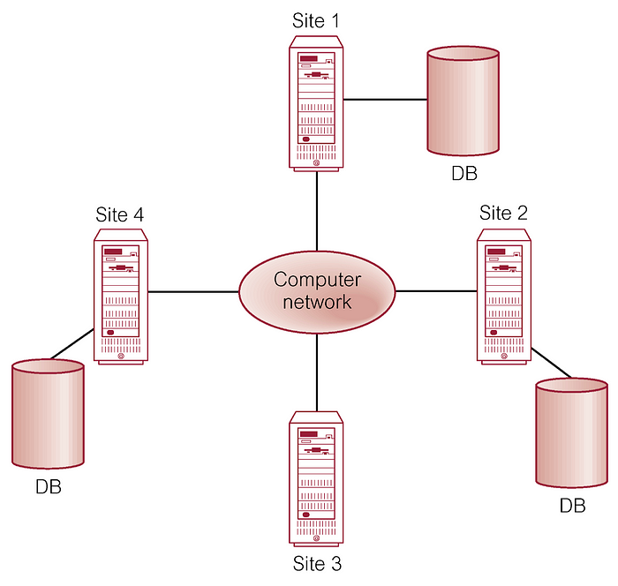

Slide 45
What is a Site?
It’s like a separate database that contains data and may also have the ability to process and respond to the requests made
Think of it like a chain of libraries (sites) spread across a city. Each library has a portion of the books (data) and can help people who visit to get the information they need. Altogether the system is distributed where each individual library is a ‘Site’
Advantages
Reflecting distributed nature of some database applications:
A company may have locations in different countries, so the databases are naturally distributed
Increased reliability and availability
Failure of a single node will not affect the breakdown of the system and will function in a reduced level or will not affect at all
Local control
Local groups have more control over ‘their’ data.
Lower communication costs
When data is more closer to the point of use, it’s cost saving
Fast response and improved performance
Some user queries may rely on the data that is stored in the local ‘site’, this may speed up the querying process. And also some complex queries can be run parallely in different sites to speed up the process
Interconnection of existing databases
This architecture offers a natural solution by integrating and interconnecting the pre-existing local databases, when need of a global approach.
Disadvantages
Cost
Way more costing than a centralised system
Communication/Processing overheads
These are frequently occurred where the system have to maintain a proper co-ordination and keep the data updated across many sites. There is also a risk in communication channels where disconnections/blackouts may lead to degrade system responsiveness
Data Integrity and consistency
Additional control mechanisms are required in order to prevent improper updating of data and avoid other problems of data integrity/consistency.

Slide 46
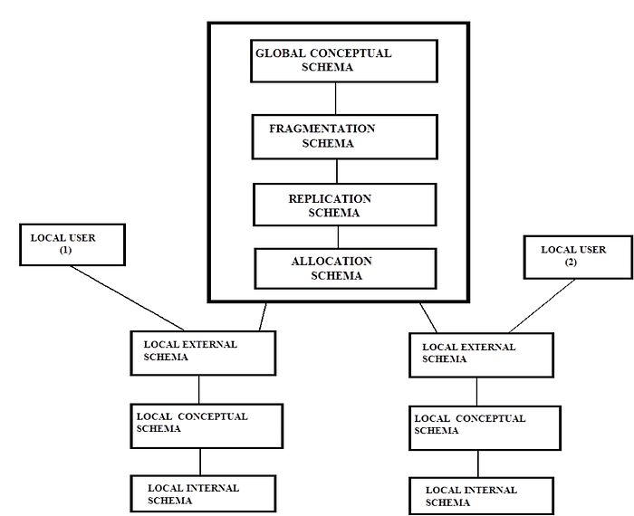
Distributed Schematic View A distributed schematic view refers to a graphical or conceptual representation of how a distributed system is organized

Slide 47
Imagine we have an online shopping platform with users, orders, and products. The system is distributed across three regions: North America, Europe, and Asia. The goal is to manage the data across these regions efficiently.
Considering the global schema, it consists of
Global conceptual schema
It refers to the abstract representation of the data across multiple databases within a distributed system. It describes how data is organised, its structure, relationships, and constraints without being tied to a specific location or physical representation.
User: stores information about users (e.g., name, email).
Fragmentation schema
Representation of how the data is split into fragments and stored in different locations. The goal is to distribute data in a way that improves query performance and optimises resource usage.

Slide 48
Divides data based on certain conditions (e.g., by region or time).
Replication schema
Same as above, it’s representing how the data is having multiple copies across different locations. This ensures that data is available for everyone from anywhere
User data could be replicated in both North America and Europe to ensure users can access their information even if one region is down.
Allocation schema
This schema focuses on how the data is stored physically. It specifies how data defined in the global conceptual schema is allocated, stored, and accessed in various distributed sites.
User data might be stored in the North America region.
The view of a local user consists of
Local external schema
Describes the database view of set of database user groups and hides the rest of the database
Users in Europe can see their own profile and order history. They don’t need to access user data from other regions.
Local conceptual schema
Description of the database that reflect entities, data attributes, relationships and constraints.
User: Users in Europe, including their personal details.
Local internal schema
Physical storage of the database (how data is actually stored in the disk)
Storage for User: The data for User is stored in a table europe_users with indexing on userID for quick lookups.
Key points to consider
The global conceptual schema defines all the data contained in the distributed database
Local external schemas describe subsets of the global conceptual schema.

Slide 50
Key Characteristics of Data Warehousing
Subject-Oriented: Organized by business subjects.
Integrated: Combines data from various sources.
Time-Variant: Tracks changes over time.
Non-Volatile: Data is read-only once stored.

Slide 51
Real-Life Example: Retail Chain
Walmart uses a data warehouse to:
- Analyze sales trends.
- Manage inventory.
- Optimize supply chains.

Slide 52
What is Data Mining?
Process of discovering patterns in large datasets.
Extracts useful insights for decision-making.

Slide 53
Key Techniques of Data Mining
Classification: Categorizes data (e.g., spam detection).
Clustering: Groups similar data points (e.g., customer segmentation).
Association Rules: Finds relationships (e.g., market basket analysis).

Slide 54
Real-Life Example: Banking
Banks use data mining to:
- Detect fraudulent transactions.
- Analyze customer credit scores.
- Predict loan defaults.

Slide 55
What is Big Data?
Refers to extremely large datasets.
Managed through specialized tools and techniques.

Slide 56
The 3 V's of Big Data
Volume: Huge amounts of data.
Velocity: High speed of data generation.
Variety: Structured, semi-structured, and unstructured data.

Slide 57
Real-Life Example: Healthcare
Wearable devices collect health metrics.
Real-time data analysis helps monitor patients.
Predicts health risks early.

Slide 58
Technologies Used
Hadoop, Spark: Data processing.
NoSQL Databases: Storing unstructured data.
Cloud Platforms: AWS, Azure, Google Cloud.

Slide 59
Integration of Data Warehousing, Data Mining, and Big Data
Big Data feeds into Data Warehousing.
Data Warehousing stores organized data.
Data Mining extracts insights from the warehouse.

Slide 62
Hashing in DBMS
In a huge database structure, it is very inefficient to search all the index values and reach the desired data. Hashing technique is used to calculate the direct location of a data record on the disk without using index structure.
In this technique, data is stored at the data blocks whose address is generated by using the hashing function. The memory location where these records are stored is known as data bucket or data blocks.

Slide 63
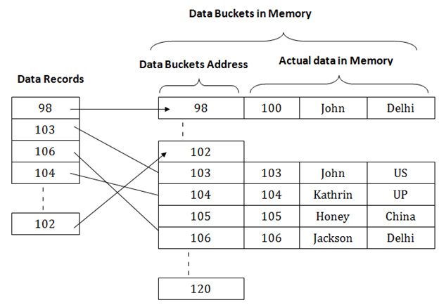

Slide 64
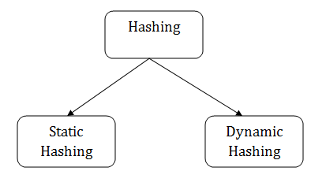

Slide 65
Static Hashing
In static hashing, the resultant data bucket address will always be the same. That means if we generate an address for EMP_ID =103 using the hash function mod (5) then it will always result in same bucket address 3. Here, there will be no change in the bucket address.
Hence in this static hashing, the number of data buckets in memory remains constant throughout. In this example, we will have five data buckets in the memory used to store the data.

Slide 66
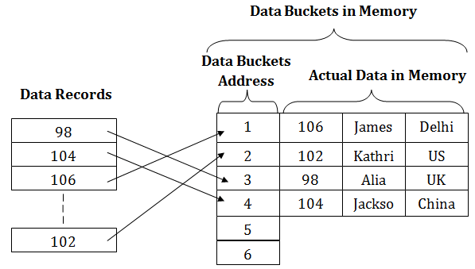

Slide 67
Operations of Static Hashing
Searching a record
When a record needs to be searched, then the same hash function retrieves the address of the bucket where the data is stored.
Insert a Record
When a new record is inserted into the table, then we will generate an address for a new record based on the hash key and record is stored in that location.
Delete a Record
To delete a record, we will first fetch the record which is supposed to be deleted. Then we will delete the records for that address in memory.
Update a Record
To update a record, we will first search it using a hash function, and then the data record is updated.
If we want to insert some new record into the file but the address of a data bucket generated by the hash function is not empty, or data already exists in that address. This situation in the static hashing is known as bucket overflow. This is a critical situation in this method.

Slide 68
Consider a hash function: Y = K % N, where ‘K’ is a key, ‘N’ is the size of the hash table, and ‘Y’ is the generated value.
Let us suppose the size of the hash table is 10. In that case, the values will be generated in the following ways.
(Also see, Index Mapping)
Key | Function | Value
17 | 17 % 10 = 7 | 7
23 | 23 % 10 = 3 | 3
34 | 34 % 10 = 4 | 4
51 | 51 % 10 = 1 | 1
67 | 67 % 10 = 7 | 7

Slide 69
Hash Table in Data Structure
A hash table is a data structure that efficiently stores and retrieves key-value pairs using a hash function to compute an index for each key. The key-value pairs are stored in an underlying array, with the hash function determining the index for each key. When multiple keys map to the same index (collisions), they are resolved with the help of techniques like chaining or open addressing. Hash tables provide fast average-case complexity (O(1)) for insertion, deletion, and searching operations, making them efficient for large datasets. However, the worst-case complexity can be O(n) if there are many collisions or a poor hash function. Hash tables are used for implementing caches, symbol tables, and dictionaries.
What is a Hash Collision?
A hash collision, or simply a collision, occurs in a hash table when two or more distinct keys map to the same hash value or index in the underlying array. In other words, the hash function generates the same hash code for different keys, causing them to be stored at the same location in the hash table.
Collisions are a common problem in hash tables because it is generally impossible to design a perfect hash function that avoids collisions entirely, especially when the number of possible keys is much larger than the size of the hash table.
When a collision happens, it needs to be resolved to maintain the integrity and efficiency of the hash table

Slide 70
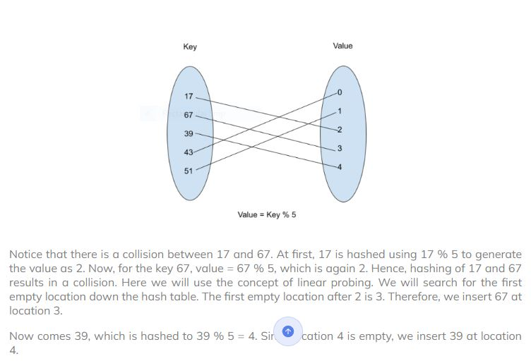
Linear Probing Whenever a collision occurs, we try to find a new empty location for the key down the hash table. Whenever we find an empty location, we store the key on that location.

Slide 71
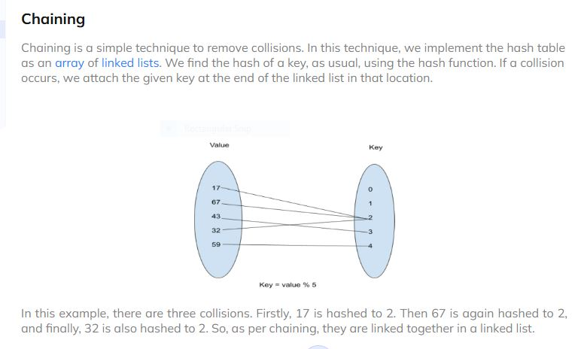

Slide 72
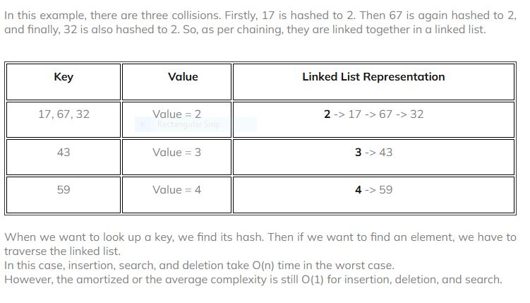

Slide 73
Here's a more detailed explanation:
What it is: RAID combines multiple physical hard drives (or SSDs) into a single logical unit, allowing for data striping and/or mirroring to enhance performance and/or data protection.
Benefits:
Increased Performance: By distributing data across multiple drives, RAID can improve read and write speeds.
Data Redundancy and Protection: RAID levels offer different levels of data redundancy, ensuring data recovery in case of drive failure.
Fault Tolerance: RAID systems can continue to operate even if one or more drives fail, depending on the RAID level.

Slide 74
RAID devices use different versions called levels. The original paper that coined the term and developed the RAID setup concept defined six levels of RAID -- 0 through 5. This numbered system differentiated the capabilities of the RAID versions. The number of levels has since expanded and has been broken into three categories: standard, nested and nonstandard RAID levels.
RAID Levels: There are various RAID levels, each with its own strengths and weaknesses:
RAID 0 (Striping): Focuses on performance by distributing data across multiple drives without redundancy. If one drive fails, all data is lost.
RAID 1 (Mirroring): Duplicates data across multiple drives, providing high redundancy and fault tolerance. If one drive fails, the data is still available on the other mirrored drive.
RAID 5 (Striping with Distributed Parity): Combines data striping with parity information distributed across multiple drives, providing both performance and redundancy.
RAID 10 (Mirrored Striping): Combines RAID 1 and RAID 0, offering both redundancy and performance.
Hardware vs. Software RAID:
Hardware RAID: Uses a dedicated RAID controller card to manage the array, offering better performance and reliability.
Software RAID: Implemented by the operating system, requiring less hardware but potentially impacting system performance.
RAID 6 (Double Parity): Offers even higher redundancy than RAID 5, allowing for the failure of two disks without data loss.
RAID 3: Uses a dedicated parity disk for data redundancy.
RAID 4: Uses a dedicated parity disk for data redundancy.
https://www.techtarget.com/searchstorage/definition/RAID

Slide 75
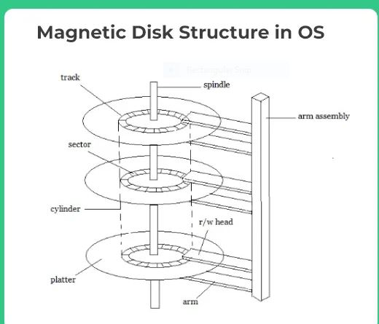

Slide 76
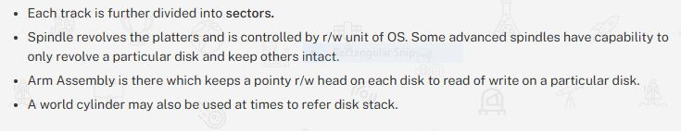
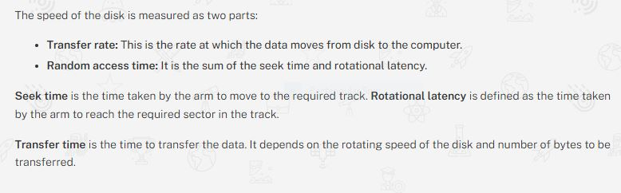

Slide 77
File organization
File organization and indexing are fundamental concepts in database management systems (DBMS) that deal with efficient storage, retrieval, and management of data.
File Organization
File organization refers to the arrangement of data on storage devices. The method chosen can have a profound effect on the efficiency of various database operations.
Common methods of file organization include:Sequential (or Serial) File Organization
In sequential file organization, records are stored in sequence, one after the other, based on a key field. This key field is a unique identifier for records, ensuring that they have some order. The records are inserted at the end of the file, ensuring the sequence is maintained.
Features of Sequential File Organization
Ordered Records: Records in a sequential file are stored based on a key field.
Continuous Memory Allocation: The records are stored in contiguous memory locations.
No Direct Access: To access a record, you have to traverse from the first record until you find the desired one.
Advantages Sequential File Organization
Simplicity: The design and logic behind sequential file organization are straightforward.
Efficient for Batch Processing: Since records are stored in sequence, sequential processing (like batch updates) can be done efficiently.
Less Overhead: There's no need for complex algorithms or mechanisms to store records.
Disadvantages Sequential File Organization
Inefficient for Random Access**: If you need a specific record, you may have to go through many records before finding the desired one. This makes random access slow.
Insertion and Deletion**: Inserting or deleting a record (other than at the end) can be time-consuming since you may need to shift records to maintain the order.
Redundancy Issues**: There's a risk of redundancy if checks are not made before inserting records. For example, a record with the same key might get added twice if not checked.

Slide 78
Indexed File Organization
Indexed file organization is a method used to store and retrieve data in databases. It is designed to provide quick random access to records based on key values. In this organization, an index is created which helps in achieving faster search and access times.
Features Indexed File Organization:
Primary Data File: The actual database file where records are stored.
Index: An auxiliary file that contains key values and pointers to the corresponding records in the data file.
Multi-level Index: Sometimes, if the index becomes large, a secondary (or even tertiary) index can be created on the primary index to expedite searching further.
Advantages Indexed File Organization:
Quick Random Access: Direct access to records is possible using the index.
Flexible Searches: Since an index provides a mechanism to jump directly to records, different types of search operations (like range queries) can be efficiently supported.
Ordered Access: If the primary file is ordered, then indexed file organization can support efficient sequential access too.

Slide 79
Types of Indexes:
Single-level Index: A single index table that contains pointers to the actual data records.
Multi-level Index: An index of indexes. This hierarchical approach reduces the number of accesses (disk I/O operations) required to find an entry.
Dense and Sparse Indexes:
In a dense index, there's an index entry for every search key value in the database.
In a sparse index, there are fewer index entries. One entry might point to several records.
Primary and Secondary Indexes:
A primary index is an ordered file whose records are of fixed length with two fields. The first field is the same as the primary key, and the second field is a pointer to the data block. There's a one-to-one relationship between the number of entries in the index and the number of records in the main file.
A secondary index provides a secondary means of accessing data. For each secondary key value, the index points to all the records with that key value.
Clustered vs. Non-clustered Index:
In a clustered index, the rows of data in the table are stored on disk in the same order as the index. There can only be one clustered index per table.
In a non-clustered index, the order of rows does not match the index's order. You can have multiple non-clustered indexes.
Bitmap Index: Used mainly for data warehousing setups, a bitmap index uses bit arrays (bitmaps) and usually involves columns that have a limited number of distinct values.
B-trees and B+ trees: Balanced tree structures that ensure logarithmic access time. B+ trees are particularly popular in DBMS for their efficiency in disk I/O operations.
Benefits of Indexing:
Faster search and retrieval times for database operations.
Drawbacks of Indexing:
Overhead for insert, update, and delete operations, as indexes need to be maintained.
Additional storage requirements for the index structures.

Slide 80
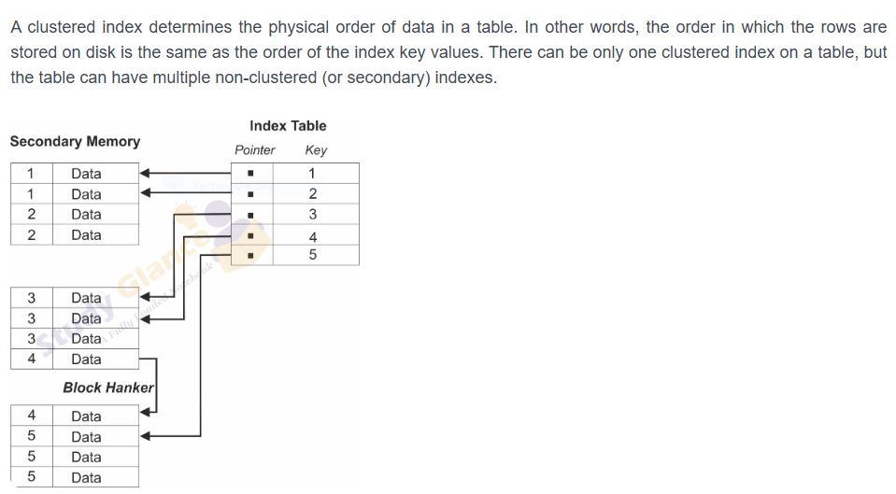

Slide 81
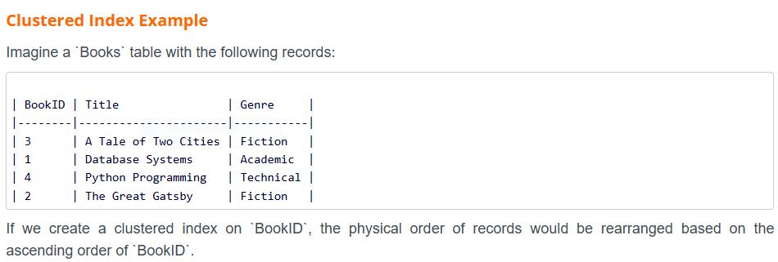

Slide 82
A primary index is an ordered file whose records are of fixed length with two fields. The first field is the same as the primary key of the data file, and the second field is a pointer to the data block where that specific key can be found.
The primary index can be classified into two types
Dense Index: In this, an index entry appears for every search key value in the data file.
Sparse (or Non-Dense) Index: Here, index records are created only for some of the search key values. A sparse index reduces the size of the index file.
Characteristics of a Primary Index:
It is based on the primary key of the table.
The primary key must have unique values.
The index entries are sorted in the same order as the data file (hence often a clustered index).
The index has one entry for each block in a data file, not for each record.

Slide 83
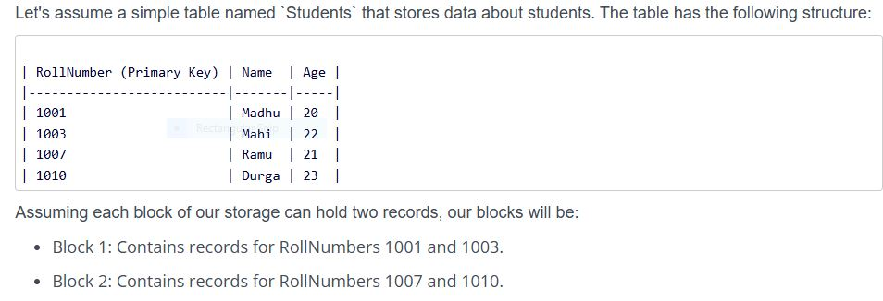

Slide 85
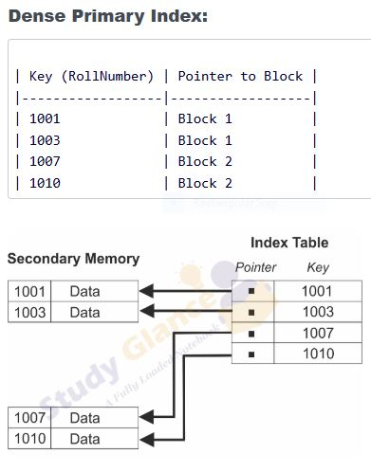

Slide 86
what is A Dynamic Index Structure
A dynamic index structure is an index that automatically adjusts its structure as the underlying data grows, shrinks, or otherwise changes. Unlike static index structures, which are fixed in size and organization, dynamic index structures reorganize themselves in response to changes in the data they index. This makes them more flexible and scalable, capable of handling varying workloads and data distributions efficiently.
Dynamic index structures are crucial for databases that are expected to evolve over time, especially when it comes to insertion, deletion, and updating of records. They maintain balanced tree structures, self-adjust, and optimize, ensuring that the database operations remain efficient even as the data grows or changes.

Slide 87
Examples of Dynamic Index Structures:
B-Trees and B+-Trees: These are perhaps the most well-known examples of dynamic index structures. B-Trees and B+-Trees automatically split or merge nodes to maintain a balanced tree, ensuring that search, insert, and delete operations take logarithmic time. They are widely used in various types of databases and filesystems.
B+ Trees
A B+ Tree is a type of self-balancing tree structure commonly used in databases and file systems to maintain sorted data in a way that allows for efficient insertion, deletion, and search operations. B+ Trees are an extension of B-Trees but differ mainly in the way they handle leaf nodes, which contain all the key values and point to the actual records.
A B+ Tree of order `n` has the following properties:
Every node has a maximum of `n` children.
Every node (except the root) has a minimum of `n/2` children.
The tree is perfectly balanced, meaning that all leaf nodes are at the same level.
All keys are stored in the leaf nodes, and the internal nodes act as 'guides' to locate the leaf nodes faster.
Operations on B+ Trees:
Search: Starts at the root and traverses down the tree, guided by the key values in each node, until it reaches the appropriate leaf node.
Insert: Inserts a new key-value pair and then reorganizes the tree as needed to maintain its properties.
Delete: Removes a key-value pair and then reorganizes the tree, again to maintain its properties.
Example of B+ Tree Operations
Q:Let's say we have a B+ Tree of order 4, and we want to insert the keys `[10, 20, 5, 6, 12, 30, 7, 17]` into an initially empty tree.

Slide 88
Insertion
1. Insert 10:
- The tree is empty, so 10 becomes the root.
[10]
2. Insert 20:
- There's room in the leaf node for 20.
[10, 20]
3. Insert 5:
- Still room in the leaf node for 5.
[5, 10, 20]
4. Insert 6:
- The leaf node is full; split it and promote the smallest key in the right node to be the new root.
[10]
/ \
[5, 6] [10, 20]
5. Insert 12:
- Insert into the appropriate leaf node.
[10, , ]
/ \
[5, 6] [10, 12, 20]
6. Insert 30:
- Need to split the right leaf node, promote 20.
[10 , 20 , ]
/ | \
[5, 6] [10, 12] [20, 30]
7. Insert 7:
- Insert into the appropriate leaf node.
[10 , 20 , ]
/ | \
[5, 6, 7] [10, 12] [20, 30]
8. Insert 17:
- Insert into the appropriate leaf node and split.
[10 , 20 , ]
/ | \
[5, 6, 7] [10, 12] [17, 20, 30]
- Here, the middle internal node gets split, and 17 is promoted.
.

Slide 89
[10 , 17 , 20 ]
/ | | \
[5, 6, 7] [10, 12] [17] [20, 30]
Search (for 12):
- Start at the root, go down the second child because 12 > 10 and 12 < 17, and find 12 in the corresponding leaf node.
Deletion (of 10):
1. Remove 10 from the leaf node.
[10 , 17 , 20 ]
/ | | \
[5, 6, 7] [12] [17] [20, 30]
2. Since the key 10 is also present in the internal node, we replace it with its in-order predecessor (or successor based on design), which is 7.
[7 , 17 , 20 ]
/ | | \
[5, 6] [7, 12] [17] [20, 30]
And that's how B+ Trees work for search, insert, and delete operations. B+ Trees are dynamic, adapting efficiently as keys are added or removed, which makes them quite useful for databases where high-speed data retrieval is crucial

Slide 90
Conclusion
Data Warehousing stores data.
Data Mining finds patterns.
Big Data handles massive datasets.
Together, they drive business intelligence and innovation.

Slide 91
Q&A
Any questions?
Let’s discuss!
https://studyglance.in/dbms/display.php?tno=56&topic=Comparison-of-File-Organizations,-Indexes-and-Performance-Tuning

Slide 92
Thank You!
Thank You for Your Attention!
Contact: [Your Email]

Slide 93
B+ Tree
Basic Structure of B+ Tree
Internal nodes: Store keys and pointers (but not data).
Leaf nodes: Store actual data records or pointers to them.
All leaves are linked for fast range queries.
All data exists only in leaf nodes.

Slide 94
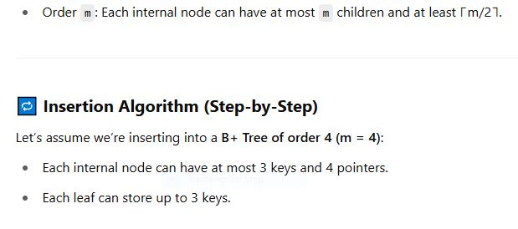

Slide 95
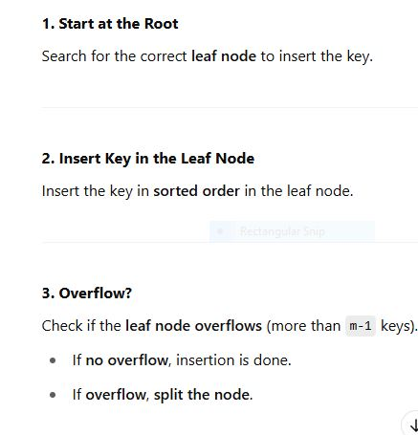

Slide 96
4. Split the Leaf Node
Split the leaf into two nodes.
Push the middle key to the parent.
Maintain leaf node links.
5 Update Parent
Insert the middle key into the parent node.
6. Propagate Splits Upward
If the parent also overflows, repeat the split upwards.
This may continue up to the root.
If the root splits, a new root is created, and the height increases.

Slide 97
ExampleLet's insert the following sequence into a B+ Tree of order 4:10, 20, 5, 6, 12, 30, 7, 17
Insert 10, 20, 5✅
All go into the same leaf: [5, 10, 20]

Slide 98
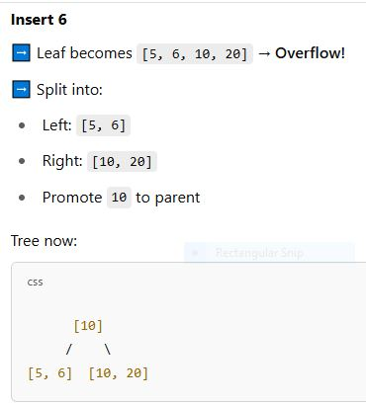

Slide 99
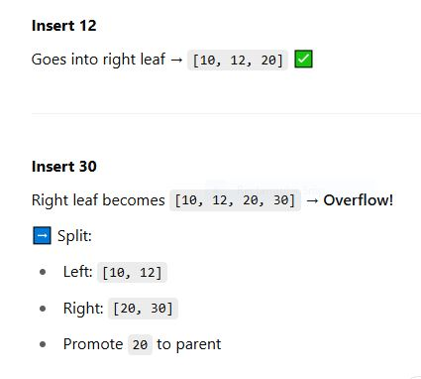

Slide 100
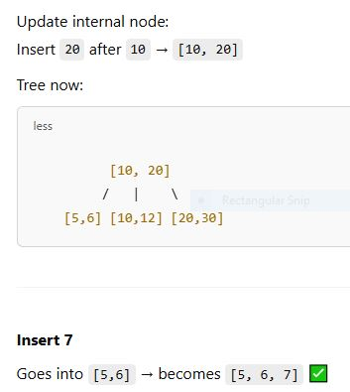

Slide 101
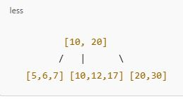
Insert 7Goes into [5,6] → becomes [5, 6, 7]
Insert 17Goes into [10, 12] → becomes [10, 12, 17]

Slide 102
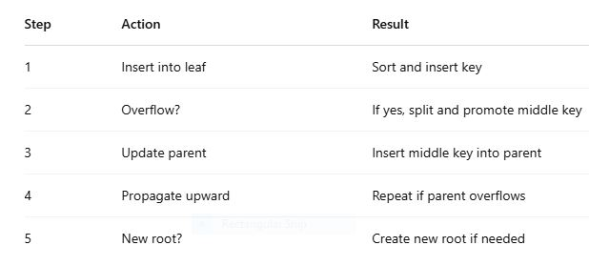

Slide 103
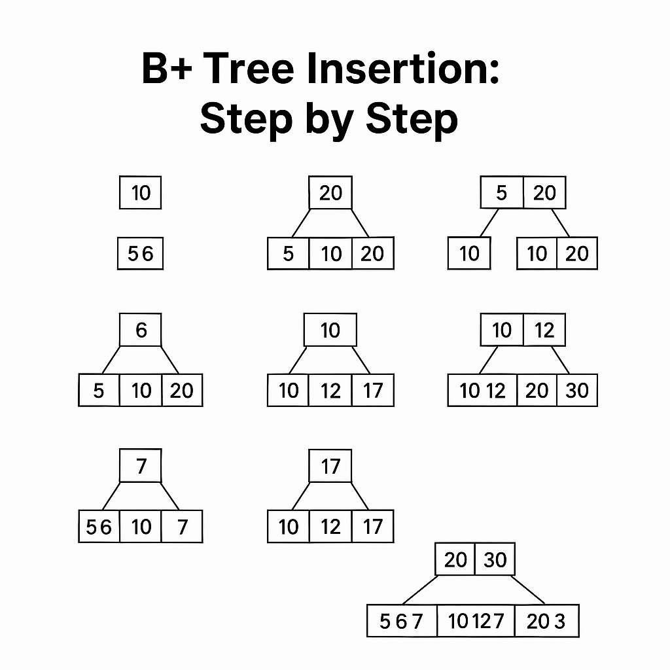

Slide 104
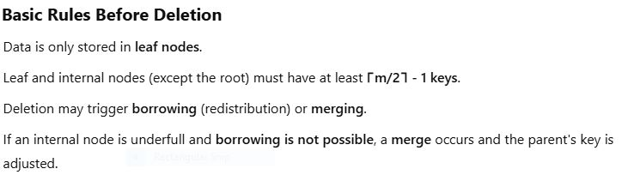
B+ Tree Deletion

Slide 105
B+ Tree Deletion Steps
Assume B+ Tree of order 4 (m=4):
Leaf nodes can hold 3 keys max and 2 keys min (⌈4/2⌉ - 1 = 1).
Internal nodes: max 3 keys, min 1 key (⌈4/2⌉ - 1 = 1).

Slide 106
B+ Tree Deletion Step
Step 1: Locate the Leaf Node
Search for the leaf node containing the key to delete.
Step 2: Remove the Key
Delete the key from the leaf node.
Step 3: Underflow Check
After deletion, check if the node still satisfies the minimum occupancy rule.
Step 4: Handle Underflow
There are 3 possibilities:
A. Redistribution (Borrowing):
Borrow a key from a sibling (left or right) with extra keys.
Adjust the parent key.
B. Merge:
Merge with a sibling if redistribution isn’t possible.
Pull down the separating key from the parent.
Delete that key from the parent node.
C. Propagate Up:
If the parent underflows, repeat the process recursively.
If the root is empty and has one child, make that child the new root.

Slide 107
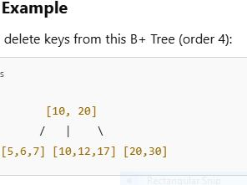

Slide 108
Delete 7,Found in [5,6,7] → becomes [5,6] ✅ Still valid → No merge/borrow needed
Delete 6,Now [5] → Underflow (only 1 key, min is 1 so still OK)
Delete 5Now node is empty → Underflow!Try redistribution from neighbor:[10,12,17] has enough keys → borrow 10Now:[10] [12,17] → parent updated from [10,20] to [12,20]

Slide 109
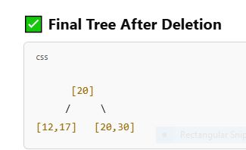
Delete 10,From [10] → becomes emptyCan’t borrow → merge with sibling [12,17]Parent key 12 is removed → parent becomes [20]

Slide 110
